Slide 1

Mining Social Media
Lab 9
Midjourney; 2024

Slide 2

Mining Social Media
Lab 9
Notes:
https://www.youtube.com/watch?v=cQ54GDm1eL0

Slide 3
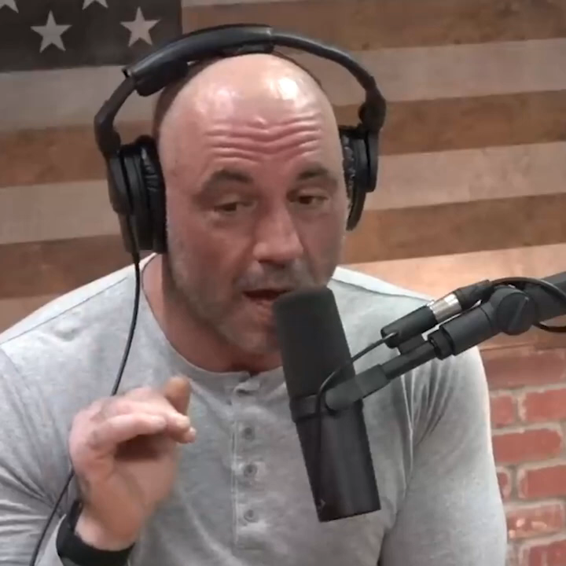
Joe Rogan
Host of “most-listened-to podcast globally” acc. to Spotify
Ben Shapiro
Lawyer, columnist, author, and conservative political pundit
Ratatouille
2007 Pixar film about a rat that cooks
This conversation never happened
Notes:
https://www.youtube.com/watch?v=we1I6nK6OBg
https://elevenlabs.io/
The audio is completely fabricated

Slide 4
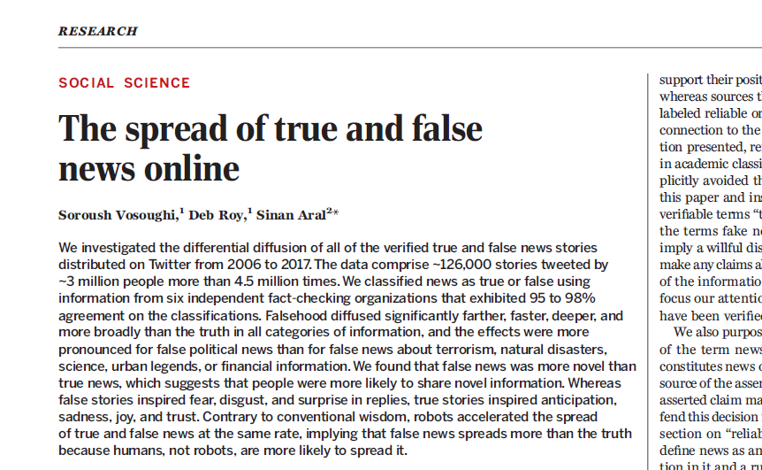
Link to paper
Notes:
Takeaways: (1) lies spread faster than the truth, (2) it’s because _people_ spread them, not bots (i.e. small groups of individuals with agendas using computer code to influence public opinions)

Slide 5
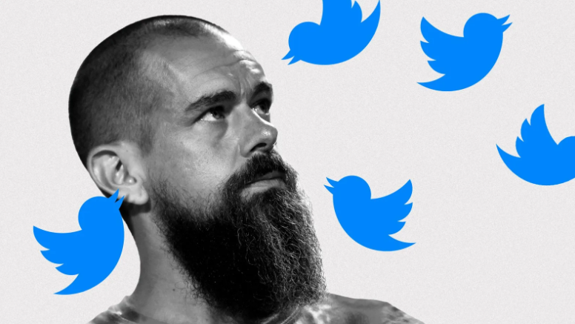
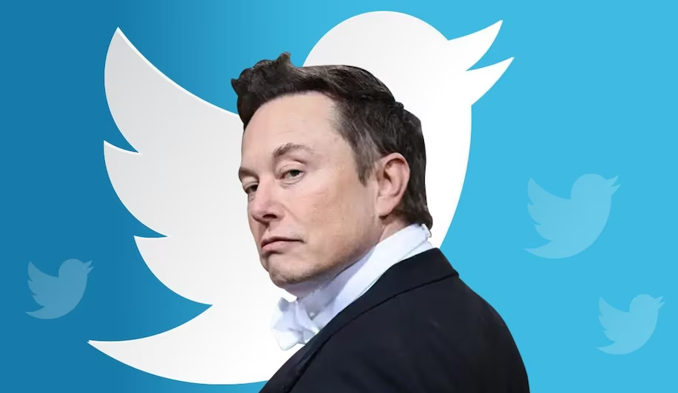
Recent changes to Twitter
2006 – Twitter founded by Jack Dorsey, Noah Glass, Evan Williams, & Biz Stone with Dorsey as CEO
2014 – Twitter daily users peaks at 661,000,000
Feb-Oct 2020 – Multiple groups attempt to “oust” Dorsey
May 2022 – Dorsey resigns and Musk offers to buy
Oct 2022 – Musk takes over; lays off 5,500 employees
Oct 2022 – Dorsey starts “Bluesky” as a Twitter alternative
Apr 2023 – Changes to Twitter API, the point is to get rid of bots and promote free speech

Slide 6
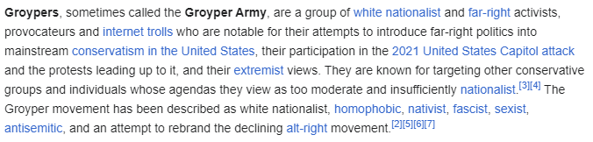
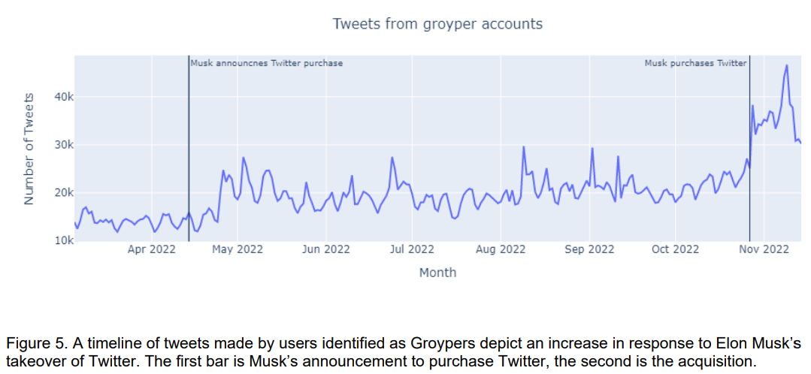

Network Contagion Research Institute
Notes:
Hate groups see Musk Twitter buyout as a chance to spread their agenda. Point is: what is the appropriate way to regulate social media?
https://networkcontagion.us/reports/2-8-23-twittertakeover-how-the-musk-acquisition-became-a-launchpad-for-gen-z-neo-nazis-ye-and-widespread-antisemitism/

Slide 7
Agenda
Scraping Reddit with R
Turning words into numbers
“If you can quantify it, you can do science with it”
- Dr. Sarah Woolley (Columbia Psychology)

Slide 8
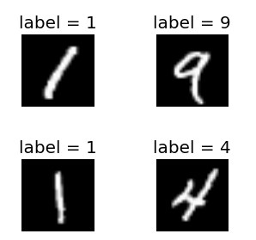
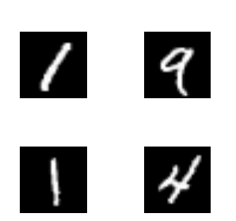
Unsupervised learning
Supervised
Ground truth available
Unsupervised
Ground truth unavailable

Slide 9
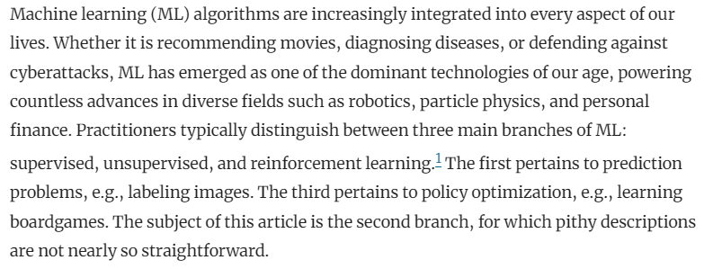
Unsupervised learning
Clustering
Abstraction
Generative models
Watson (2023) On the Philosophy of Unsupervised Learning
Notes:
Clustering – dimensionality reduction
Abstraction – dimensionality creation
Generation – creating new data based on reduced or abstracted dimensions

Slide 10
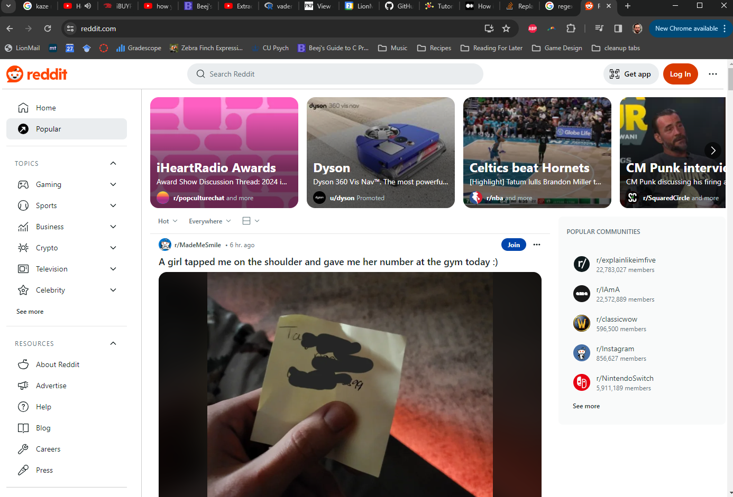
Notes:
What feeling do you get from this first post? Positive? Negative? Neutral? We’ll learn to quantify that “sentiment”
73 million daily users
268 million weekly users
100,000+ active “subreddits”
$804,000,000 in revenue in 2023
Stats from: https://backlinko.com/reddit-users

Slide 11
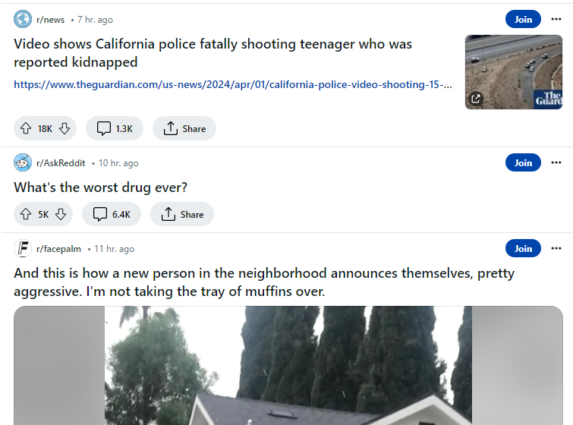
subreddit
thread
up/down-votes
comments
Notes:
Structure of reddit posts and communities (subreddits, threads, upvotes & downvotes, comments)

